Slide 1

QRT BOT
Department of CSE
Jyothi Engineering College
Thrissur
January 20 , 2021

Slide 2
Group Members :
Joshua Joseph (JEC17CS059)
Josin George (JEC17CS060)
Sangeetha C P (JEC17CS086)
Shilpa Sivadas ( JEC17CS093)
MENTOR : Mr Unnikrishnan P (Assistant Professor)
Project Repository Link: https://github.com/ShilpaSivadas24/Group21_FinalProject

Slide 3
Vision of the Department
Creating eminent and ethical leaders in the domain of Computational Sciences through quality professional education with a focus on holistic learning and excellence.
Mission of the Department
To create technically competent and ethically conscious graduates in the field of Computer Science and Engineering by encouraging holistic learning and excellence.
To prepare students for careers in Industry, Academia and the Government.
To instill Entrepreneurial Orientation and research motivation among the students of the department.
To emerge as a leader in education in the region by encouraging teaching, learning, industry and societal connect.

Slide 4
Project Abstract
PProject Abstractroject Abstract
Due to COVID-19 pandemic, many people have become paranoid about whether they have contracted the virus or not and are deprived of social contact. To solve both of these issues we introduce QRT BOT, a chatbot that provides two major functions, recognizing symptoms of COVID-19 for users and predicting if they have chance of being COVID-19 positive, as well as providing a means for social interaction for people in quarantine.

Slide 5
Project Objective
Raise awareness among people regarding Covid 19
Help people fight against this deadly disease

Slide 6
Chatbots in the fight against the COVID-19 pandemic
Most prominent chatbot available “Clara”
Developed by the Center for Disease Control and Prevention (CDC).
Created to assess a user and determine if they have a high chance of being COVID-19 positive.
It does not perform any forms of sentimental analysis.
Existing System

Slide 7
Literature Survey
Medbot: Conversational artificial intelligence powered chatbot for delivering tele-health after covid-19
Features:
Database of responses created using-National Health Portal to ensure quality responses
Provides information about - the majority of prevalent diseases in India, their possible symptoms and applicable preventive measures
Advantage:
Available in many local dialects
Disadvantage:
Only has technical knowledge of diseases
Does not consider mental health

Slide 8
2) Sentiment analysis: Capturing favorability using natural language processing
Features:
Manually defined sentiment lexicon with different classifiers are used
For proper sentiment identification- used Markov model based tagger
Can discern between words which have positive polarity paired with negative connotation words
Advantage:
Uses simple algorithm compared to other sentimental analysis systems
Works with high accuracy
Disadvantage:
Cannot discern when word can have multiple meanings

Slide 9
3)Chatbot for Disease Prediction and Treatment Recommendation using Machine Learning
Features:
Identifies the symptoms of the user and thereby predicts the disease and recommends treatment
Provides with a link where details about the treatment is visible
Advantage:
Alternative to the conventional method of visiting a hospital -making an appointment with a doctor to get diagnosis.
Disadvantage:
Disease detection - less accurate

Slide 10
4) Compassion Driven Conversational Chatbot Aimed for better Mental Health
Features:
Designed by generative based learning instead of rule based
Deep Learning and NLP used for generating and understanding responses
Seq2Seq model framework used
Suggests meditation techniques, promotes yoga practices
Advantage:
Entirely free and available 24x7
Disadvantage:
Currently text-based interface

Slide 11
Description of Proposed Systems
Two major tasks:
Determine if a user has a high chance of being COVID-19 positive;
Predict users’ mental and emotional state.
This is done by analysing the interactions between the user and the chatbot.

Slide 12
Modules of proposed System
There are two modules in the proposed system:
Symptom Prediction: Analyses user replies to determine if high case of positive COVID-19.
Sentimental Analysis: Analyses the user replies to determine emotional state of user.

Slide 13
Software Requirement Specification
Functional Requirements:
Admin interface: The user interface module where the user needs to login.
Data Pre-processing and Feature extraction: User replies are taken as input from the chat.
Inform Health Authorities: Healthcare is informed about the health condition and emotional state of the user if there is a high case of severity.

Slide 14
Other Non-Functional requirements:
Performance requirements: The system should correctly predict whether the user has a chance of being affected by COVID-19 or not, and must inform healthcare if severity is high.
Safety requirements: A user’s identity is verified by username and password before any information can be provided.
Security Requirements: The conversations between the chatbots and users are encrypted.

Slide 15
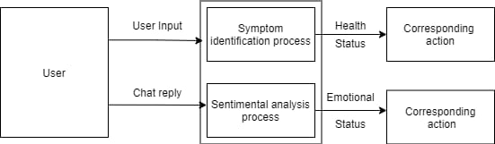
DFD Level 0

Slide 16
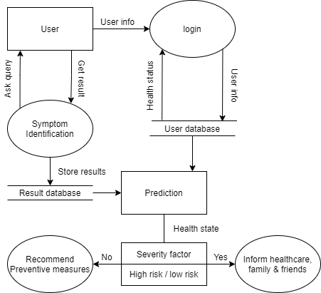
DFD Level 1- Module 1

Slide 17
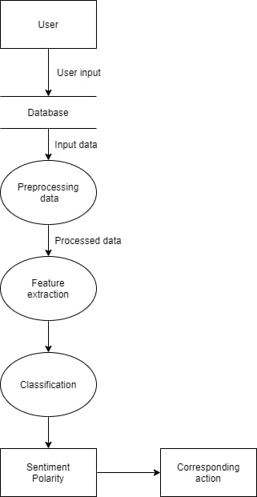
DFD Level 1- Module 2

Slide 18


DFD Level 2
TRAINING
TESTING

Slide 19
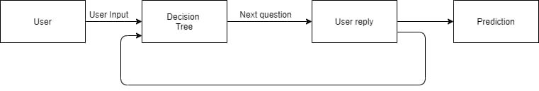
PREDICTION

Slide 20
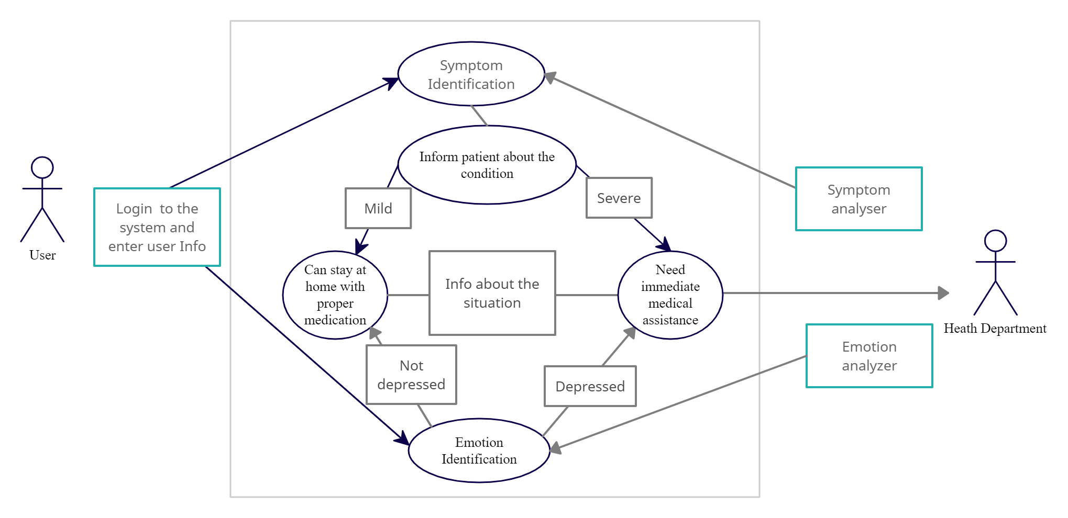
Use Case Diagram

Slide 21
Application
Help people get answers to their questions and an assessment of symptoms related to coronavirus
It can potentially lower the volume of cases in urgent care and emergency care.
It can also reduce the burden on hospital call centres.

Slide 22
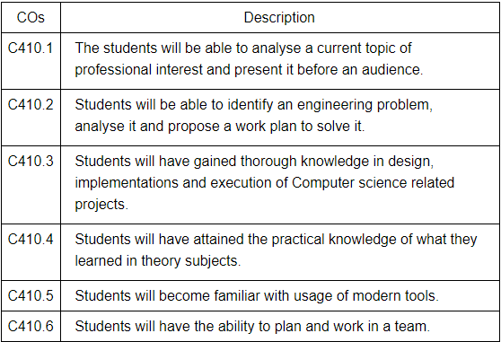
Course Outcome

Slide 23
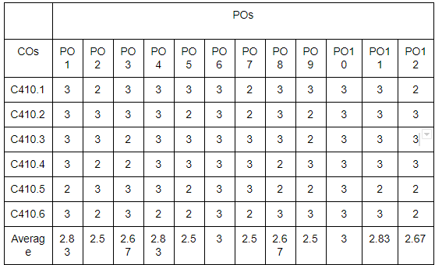
Mapping of Course Outcome to PO

Slide 24
Pending Work
Implementation - Develop a chatbot application using Android Studio and Dialogflow
Testing - Application is tested thoroughly and any defects found are assigned to developers to get them fixed.
Deployment - Once the product is tested it will be published in the app stores

Slide 25
Conclusion
A simple chatbot in the form of an app to quickly and effectively allow users to check if they have a chance of being COVID-19 positive or for emotional support during quarantine.
Non-intrusive and user friendly app that anyone can use.
Will greatly help in the fight against COVID-19.

Slide 26
References
Mathew, Rohit Binu, et al. "Chatbot for Disease Prediction and Treatment Recommendation using Machine Learning" , 2019 3rd International Conference on Trends in Electronics and Informatics (ICOEI). IEEE, 2019o
Khadikar, Sunath and Sharma, Pawan and Paygude, Priyankatinal, “Compassion Driven Conversational Chatbot Aimed for better Mental Health”, Zeichen Journal Volume 6, Issue 9, 2020
Adam S. Miner ,Liliana Laranjo and A. Baki Kocaballi, "Chatbots in the fight against the COVID-19 pandemic" npj Digital Medicine (2020) 3:65 ;
Bharti, Urmil and Bajaj, Deepali and Batra, Hunar and Lalit, Shreya and Lalit, Shweta and Gangwani, Aayushi, “Medbot: Conversational artificial intelligence powered chatbot for delivering tele-health after covid-19”,2020 5th International Conference on Communication and Electronics Systems (ICCES)
Nasukawa, Tetsuya, and Jeonghee Yi, "Sentiment analysis: Capturing favorability using natural language processing", Proceedings of the 2nd international conference on Knowledge capture.

Slide 27
Thank You !!

